Slide 1



From Data Analysis
→A Career Guidance for
Active
Job Seekers
Team ACJAT
Hanke Gu | Department of Material Science and Engineering
Shiyi Qin, Jiwei Yao | Department of Chemical Engineering
Yiyang Sheng | Department of Mathematics and Statistics

Slide 2
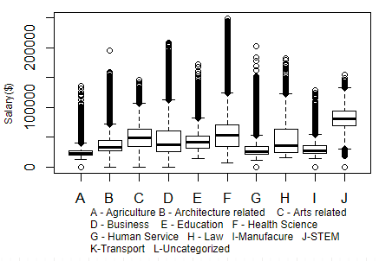
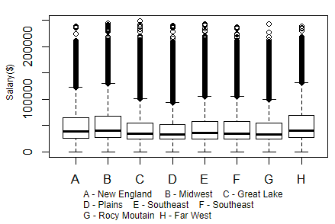
Where? What? Salary?

Slide 3
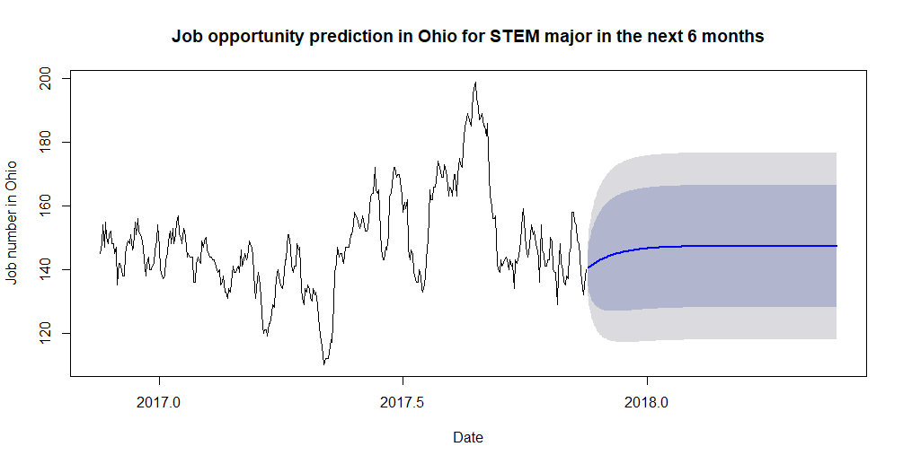
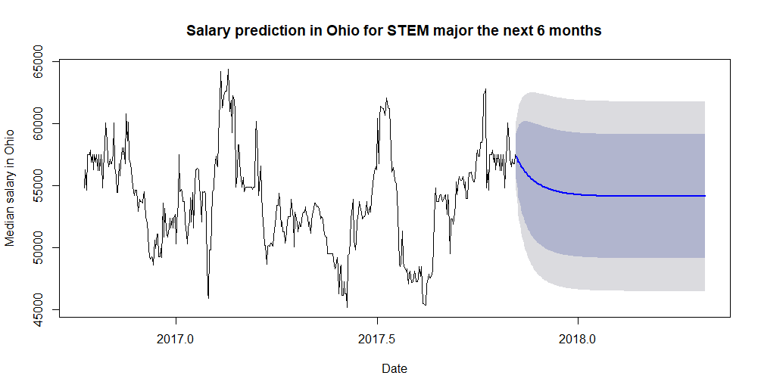
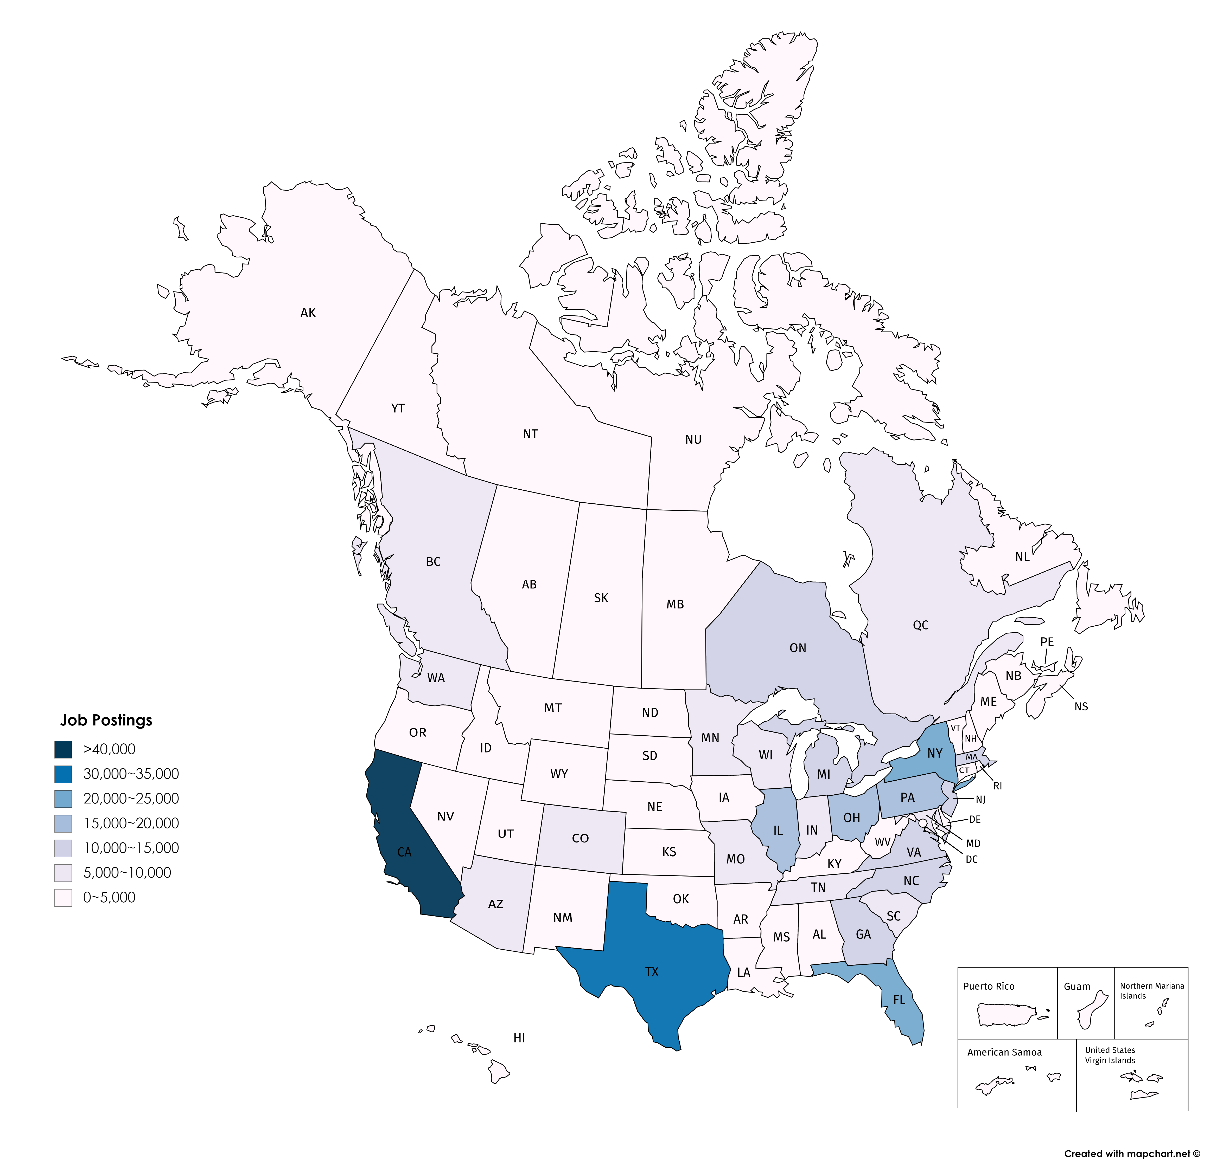
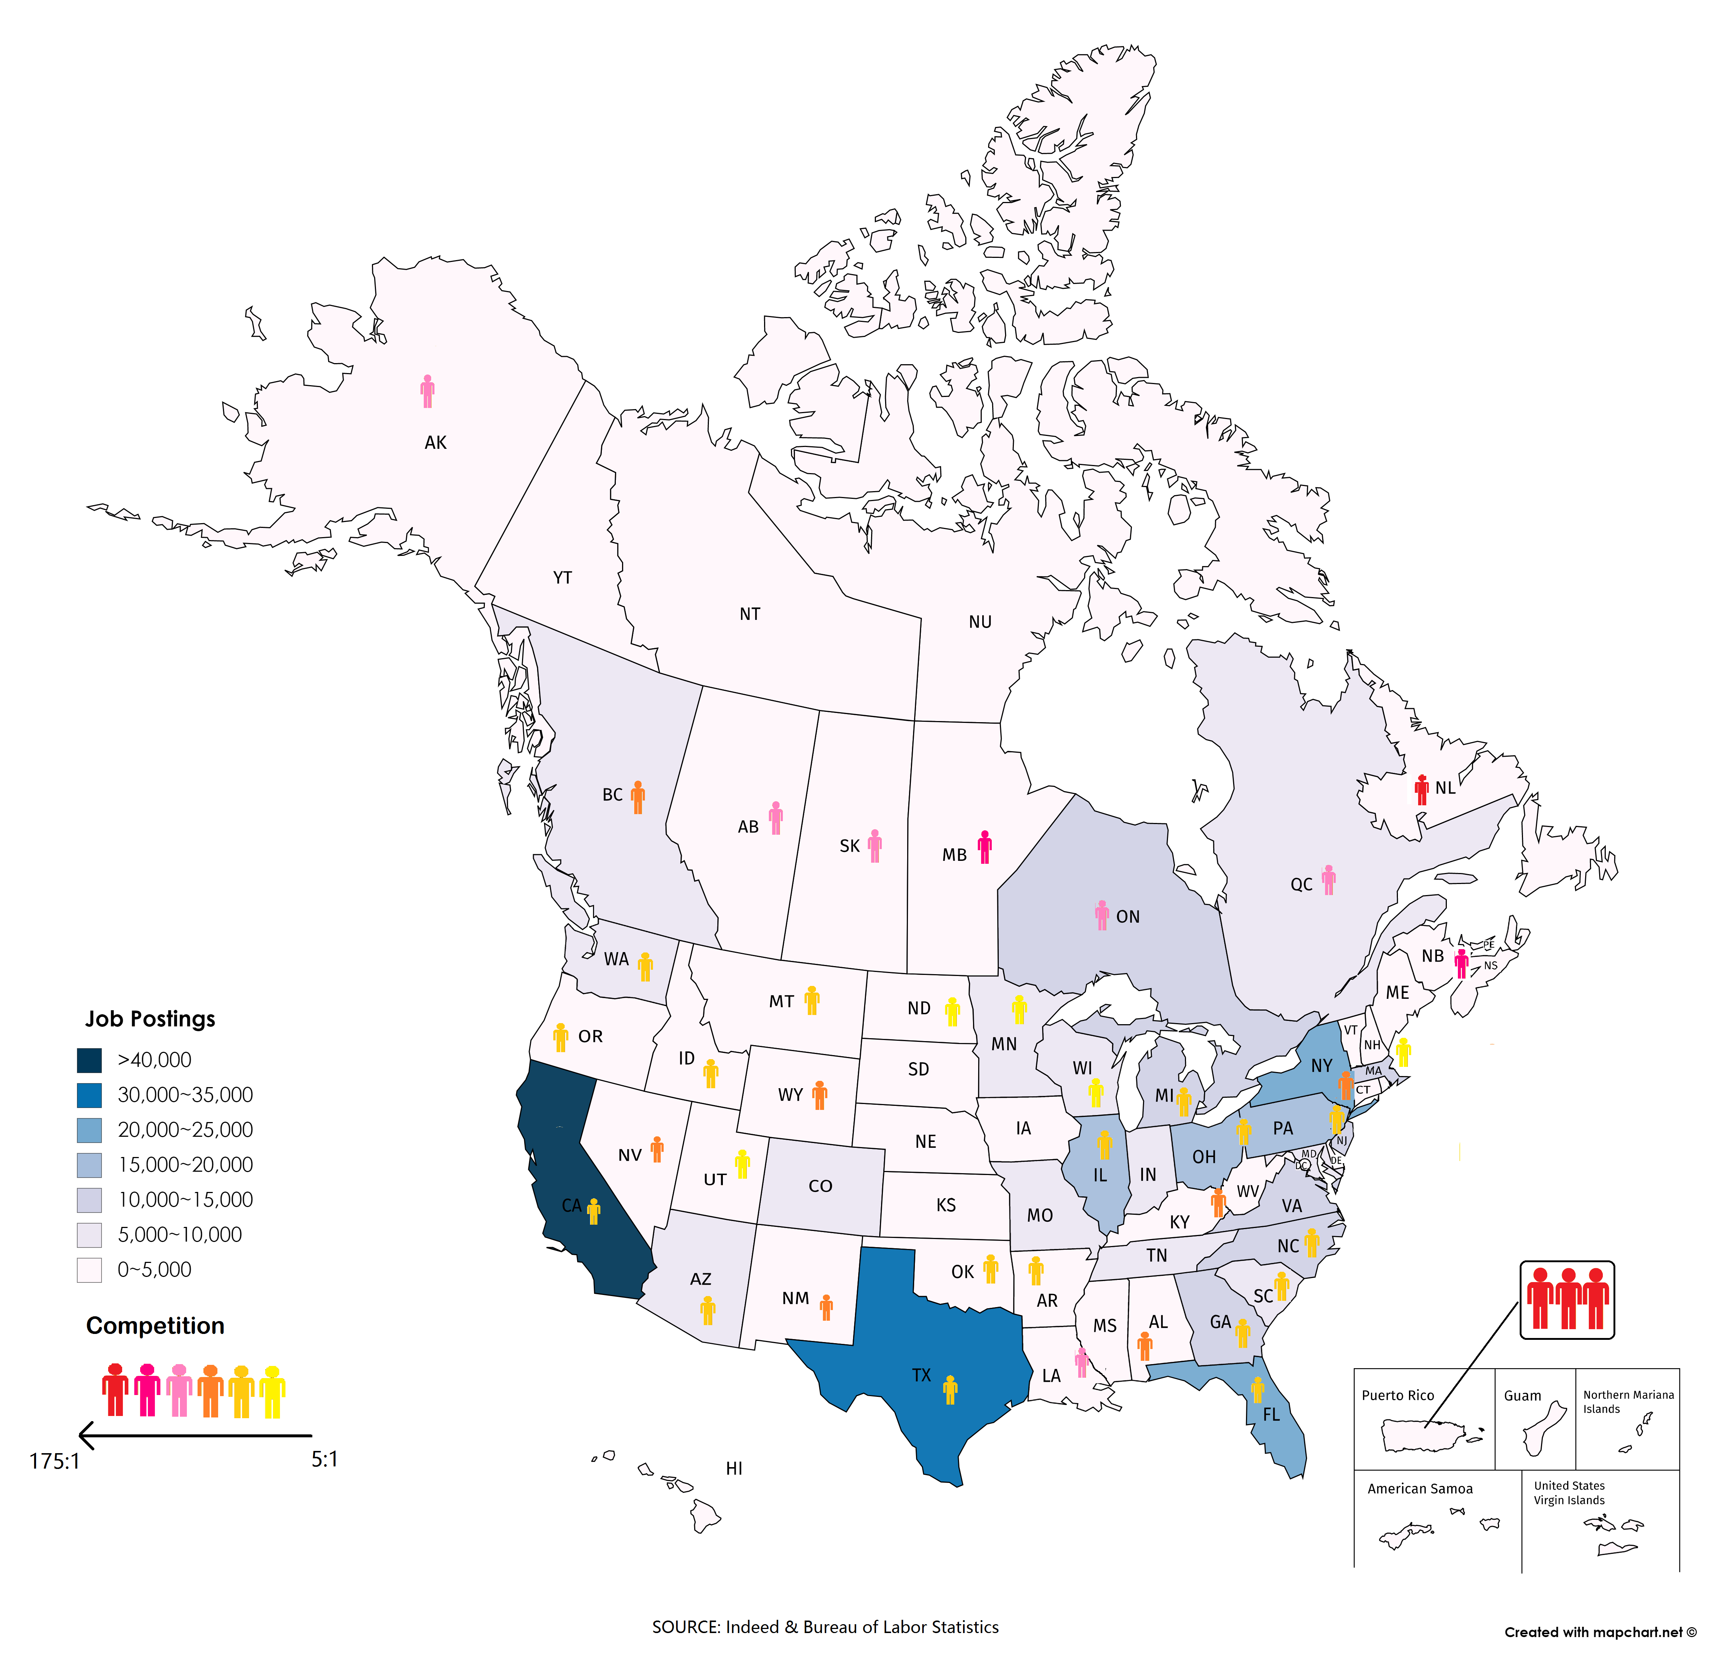
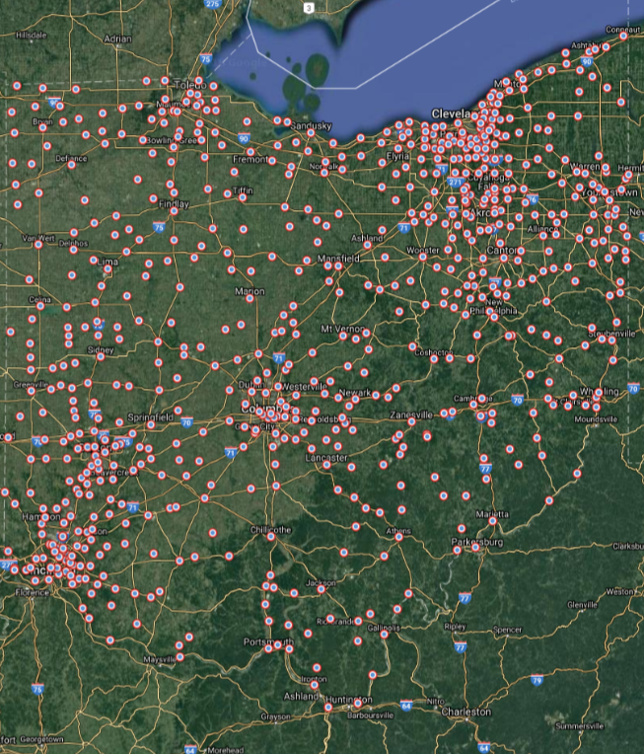

Slide 4
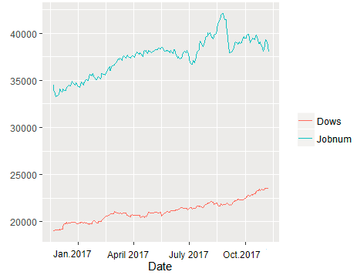
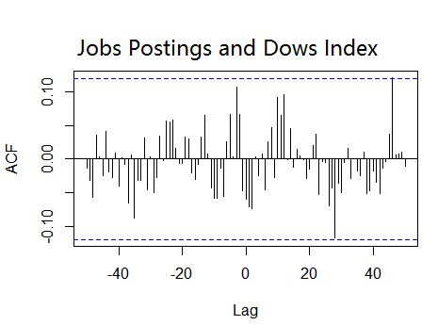
Job Market and Economy: 45 days delay

Slide 5
Thank you !
Datafest Organizers
Indeed
Food & drinks
Consultants
Judges
Cheers to ourselves!
Questions?
Notes:
We all come from different departments, and it has been a great learning experience for all of us, and we really enjoyed working with each other as a team.

Slide 6
Just in case…

Slide 7
